Slide 1
Sentimental Analysis of Reviews (Natural Language Processing and Machine Learning) PrPredict a customer’s emotions without reading the reviews they wrote edict a customer’s emotions without reading the reviews they wrote Aizhen Dong
Predict a customer’s emotions without reading the reviews they wrote

Slide 2
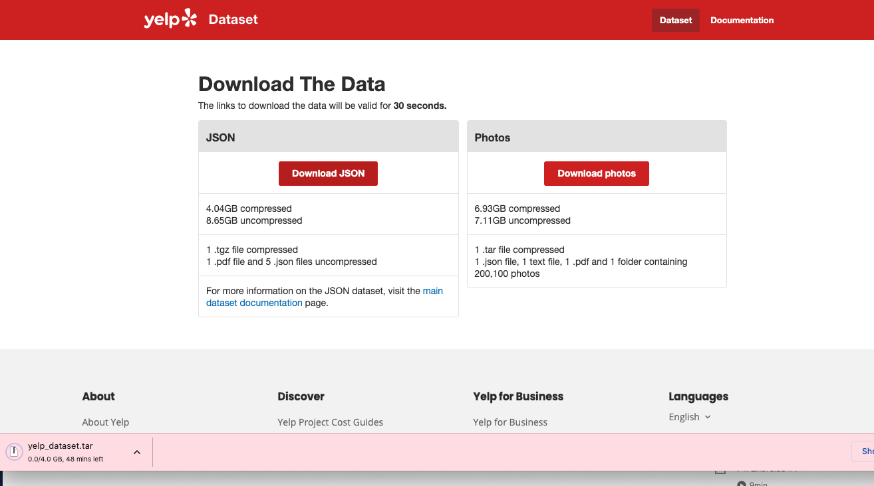
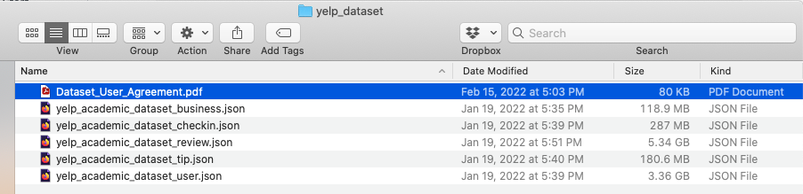
Collecting data

Slide 3
Processing data
Json - csv convert
Downsize data

Slide 4
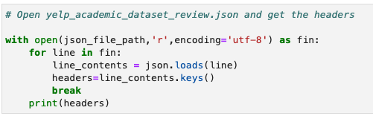
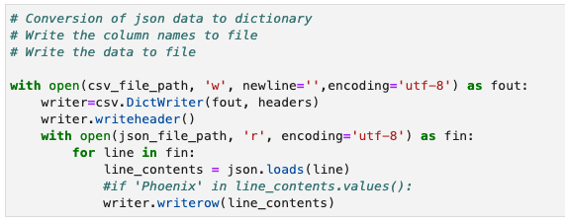
Json to csv converter

Slide 5
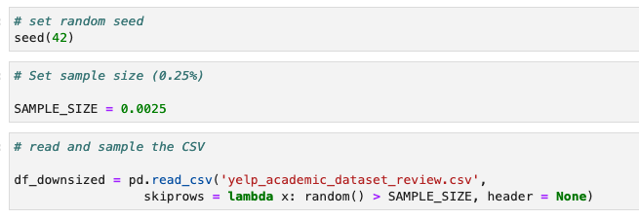
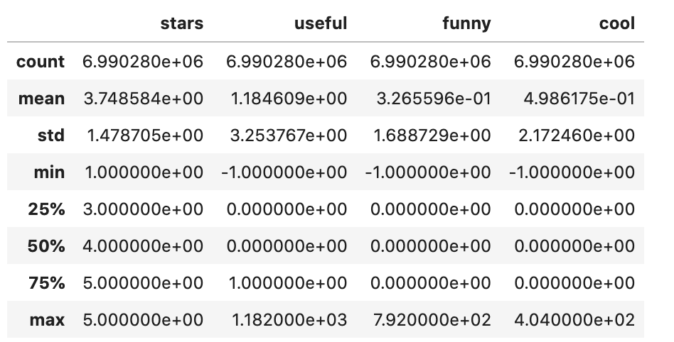
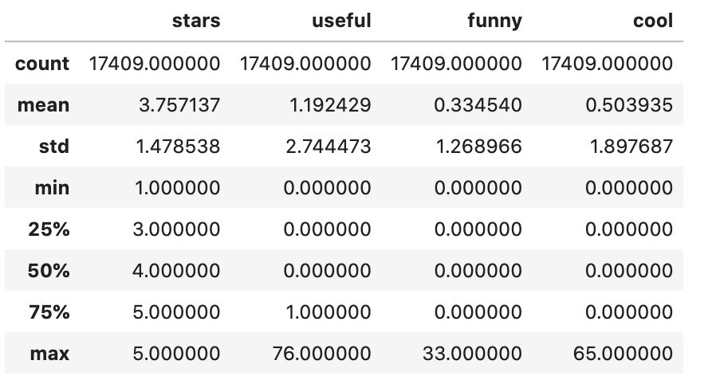
Downsize Data
Before
After

Slide 6
Visualizing, understanding and creating datasets
Texts
Stars
Create new dataframe

Slide 7
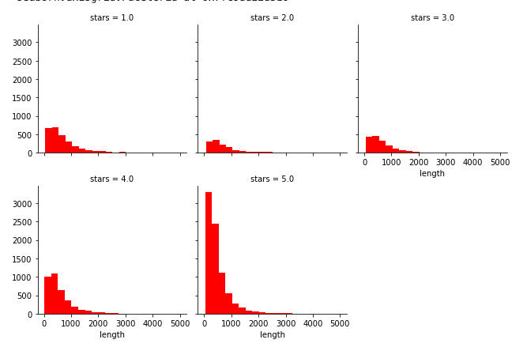
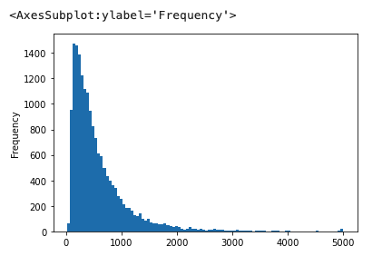
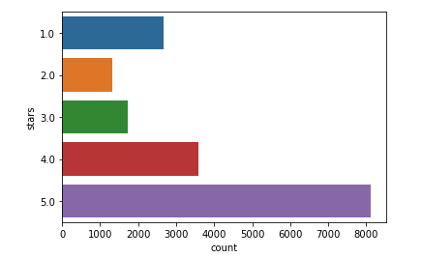
Stars
Texts

Slide 8
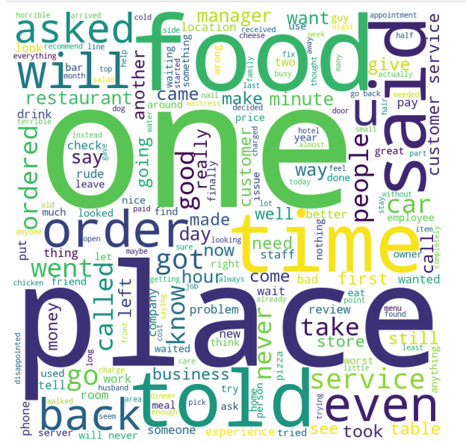

Wordcount
1-star review
5-star review

Slide 9


Data cleaning and applying NLP
Remove punctuations
Remove stopwords
Count vectorizer

Slide 10
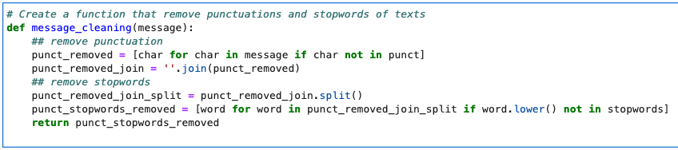
Data cleaning and applying NLP
punct = string.punctuation
stopwords = stopwords.words('english’)
vectorizer = CountVectorizer(analyzer = message_cleaning)
yelp_vectorizer = vectorizer.fit_transform(yelp_df_1_5['text’])
vectorizer.get_feature_names_out()
print(yelp_vectorizer.toarray())

Slide 11
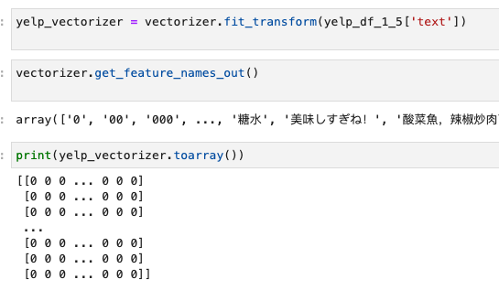
Model Training
Create features (X) and targets (y) sets
Create training and testing datasets
Create a multinomialNB model
Fitting the model
Multinomial Naive Bayes

Slide 12
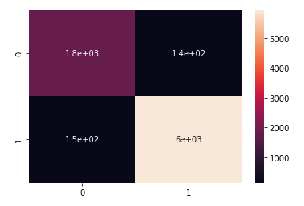
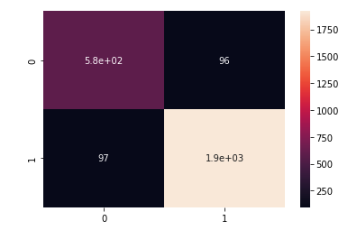
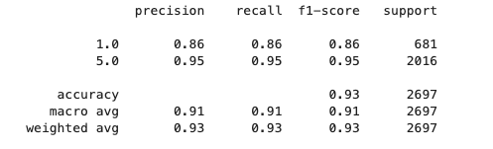
Results
Confusion matrix (Train)
Confusion matrix (Test)
Classification Report

Slide 13
Streamlit Test
I went in the store today and I was making my purchase. I didn't have my sallys card so she said I could use my cosmoprof card. So I hand the lady my cosmoprof card and she looks at it and then proceeds to say, "sorry I have to do this" and rips my card to pieces and throws it in the trash. It was extremely rude.
Sooter's is the best! I took my car here when I was having an issue with it not starting sporadically. The dealership hadn't been able to diagnose it, but the mechanics at Sooter's are amazing and were able to figure out the issue (my after-market remote start system) and fix my car for a really reasonable price. It can be hard to find mechanics that don't try to rip you off or talk down to you (esp as a woman), so it's great to have found a place like this.

Slide 14
Thank you!

